Slide 1
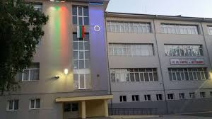
My school
By: Viktoria Tancheva, Konstsntina
Kostova and Radost Gerova, 6v grade

Slide 2
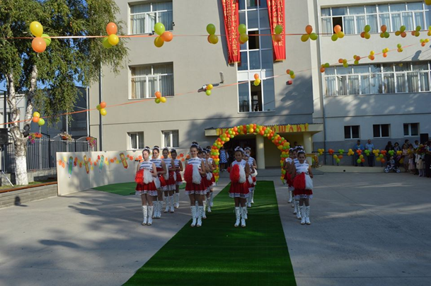
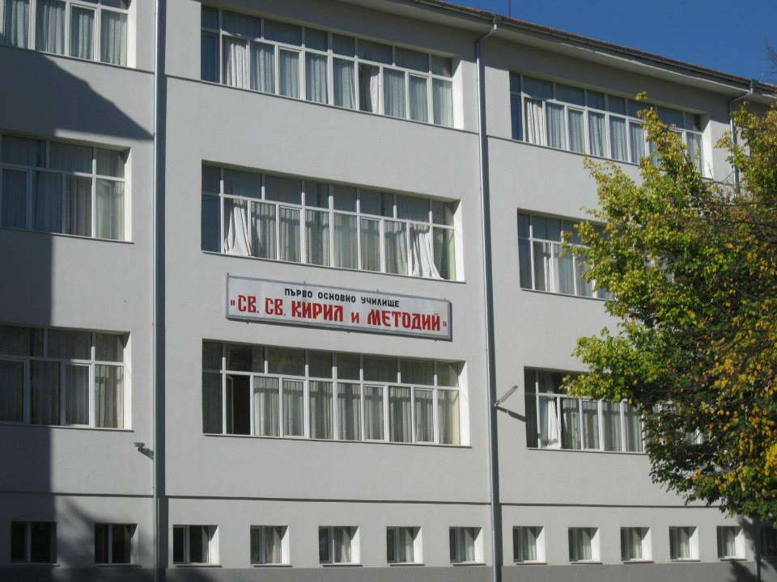
First Primary School "St. St. Cyril and Methodius " is one of the biggest schools in the Southwest region. There are about 600 students from 1 to 7 grade and 51pedagogical specialists.

Slide 3
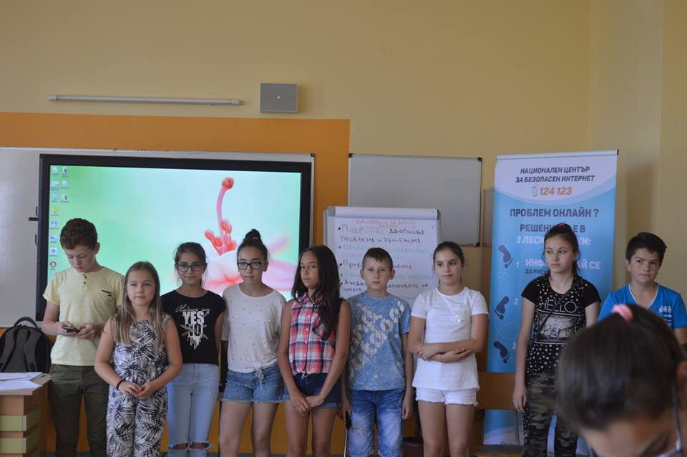
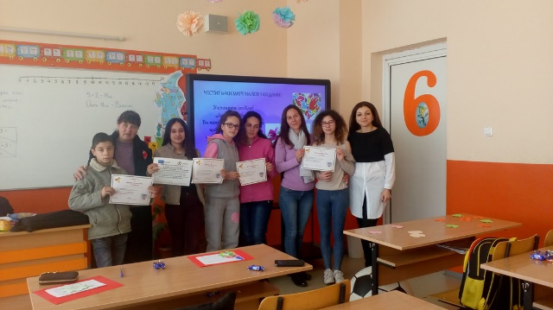
The school has a pedagogical counselor, a speech therapist, a resource teacher. An advantage of the school is a fulltime training organization with 12 clusters of comprehensive training for students from grades 1 - 6.

Slide 4
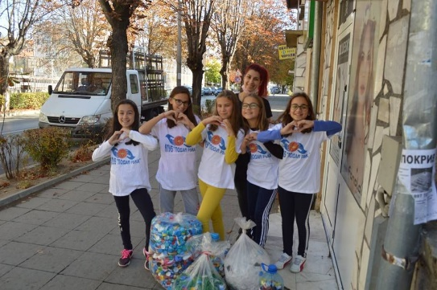
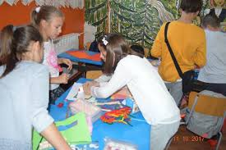
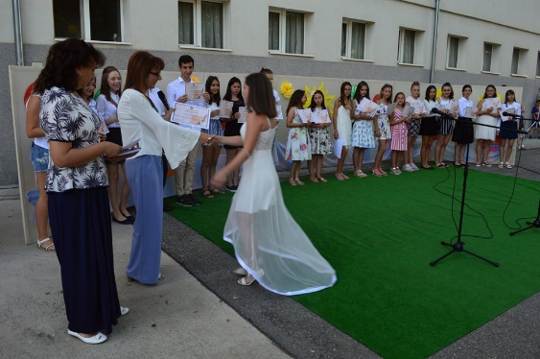
For intellectual, emotional, social, spiritual, psychological and physical
development and support of each student in accordance with the age, necessity, ability and interest of the school and clubs of interest:
Entrepreneurship, Sports. Our pupils win prizes at competitions and Olympiads in ICT, English, Arts, Robotics, Bulgarian languages, Nature studies, History

Slide 5
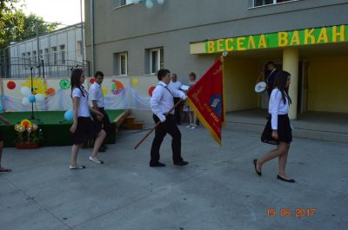
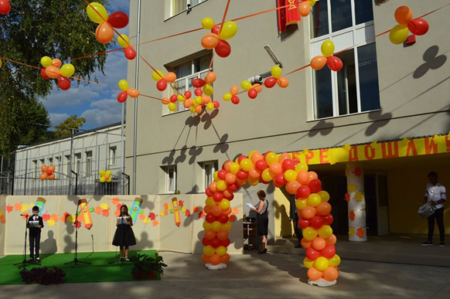
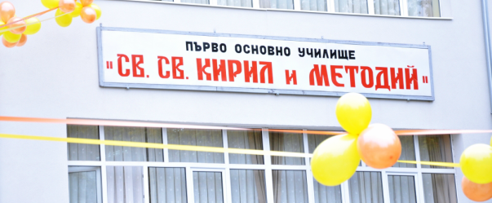
Celebrations are always organized at the end and the beginning of the school year, as well as during the individual holidays. On them all students and teachers gather in the school yard, where there is always something prepared related to the holiday.

Slide 6
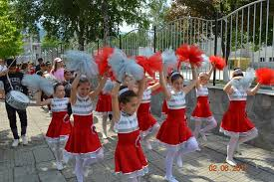
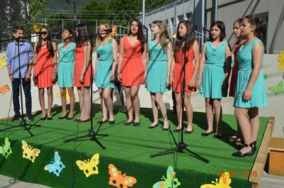
Cheerleaders dance, others sing songs, and others recite poems. In this way, everyone gets involved with something small, but in the end it becomes something big, of which we are all very happy and joyful.

Slide 7
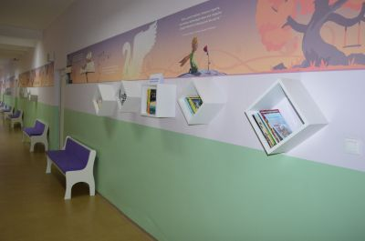
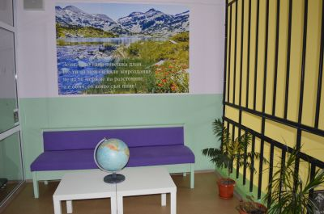
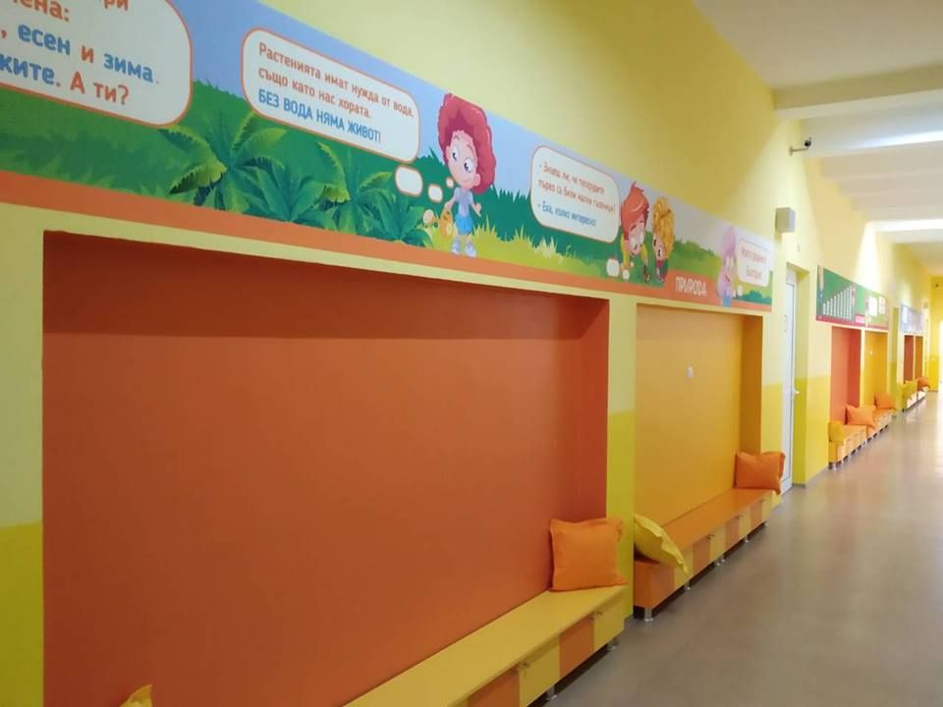
Our school is filled with cozy places where everyone can relax while studying. This helps students a lot to enjoy learning and writing their homework.

Slide 8
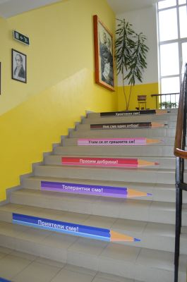
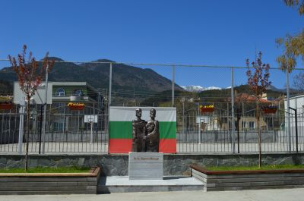
The school is decorated with shelves with books, plants, benches with pillows and beautiful wallpapers. In the yard there are flowers and even a monument of St. Cyril and Methodius.

Slide 9
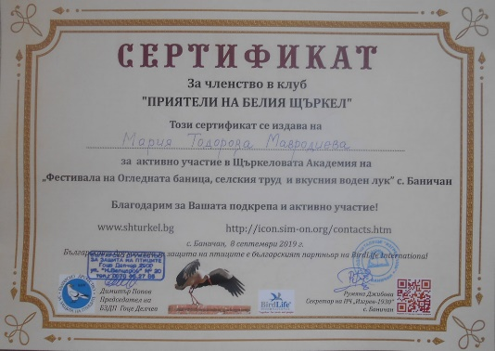
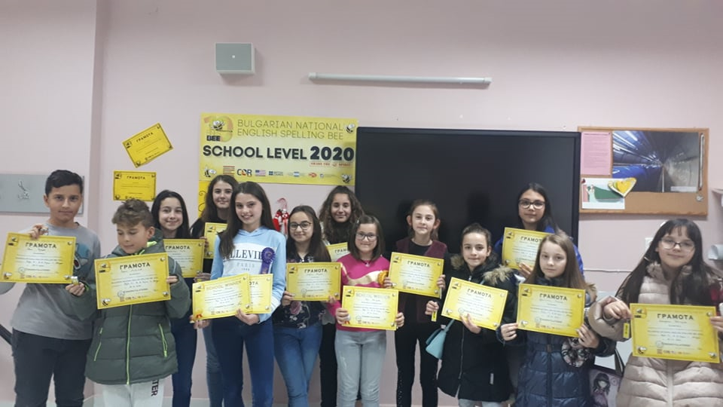
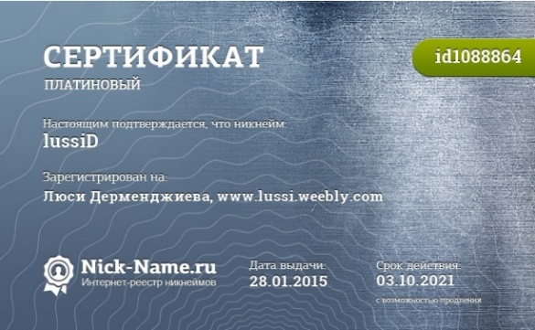
Our school has won many awards and diplomas from both information technology competitions and school competitions.
Here are some of our awards

Slide 10
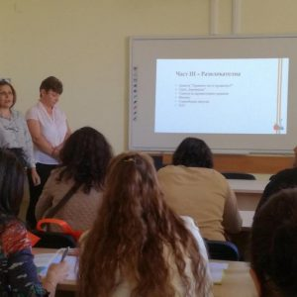
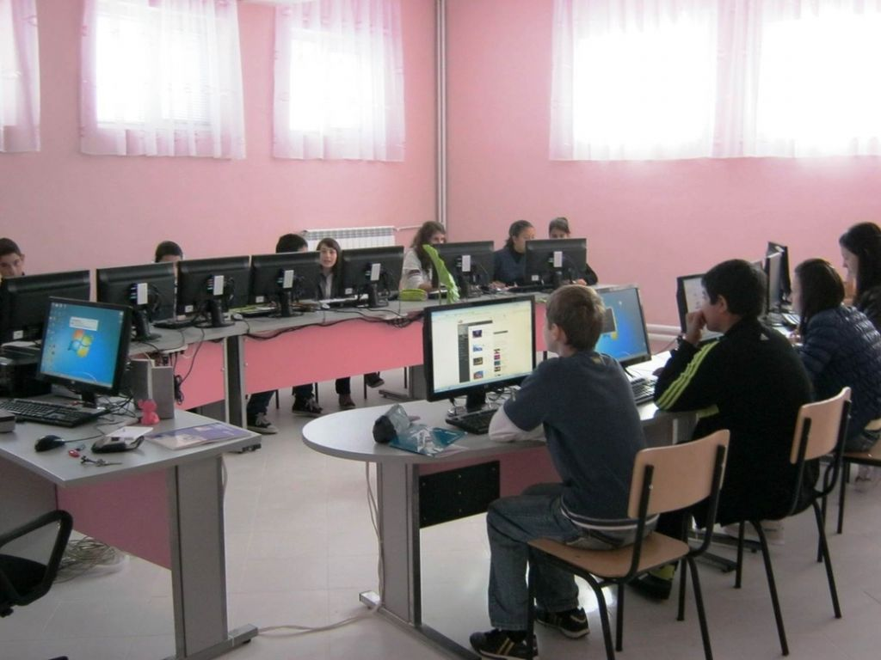
Our school is well equipped with digital aids and technical appliances. By decision № 391 of the Council of Ministers of 17.07.2017, the school is on the list of innovative schools in Bulgaria.

Slide 11
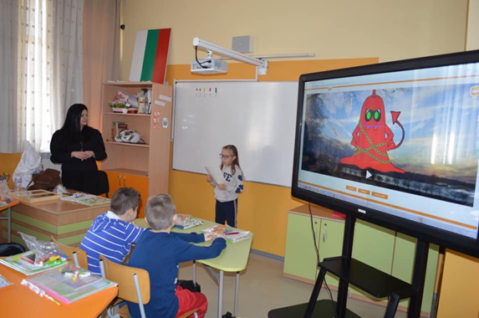
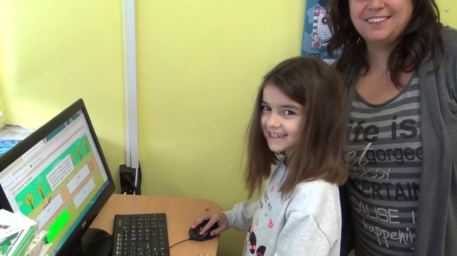
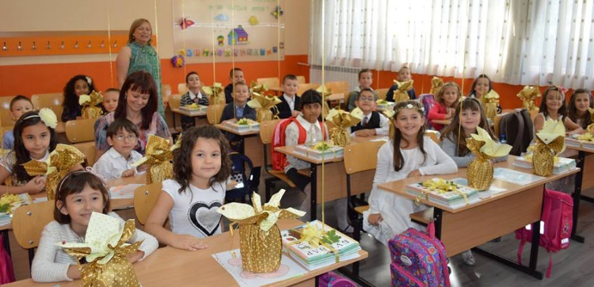
Awarded prize: "Microsoft Innovative School" - 2016 Teachers and students are open to new techniques, methods, and information exchange. The school is Involved in a large-scale project to improve the quality of education.

Slide 12
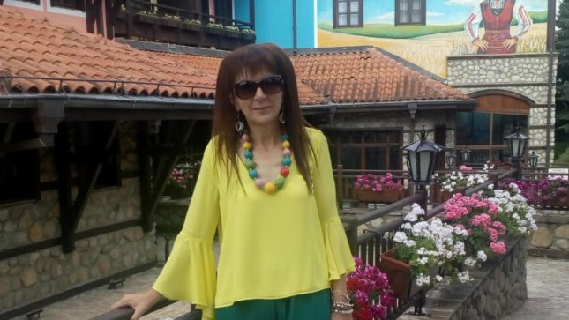
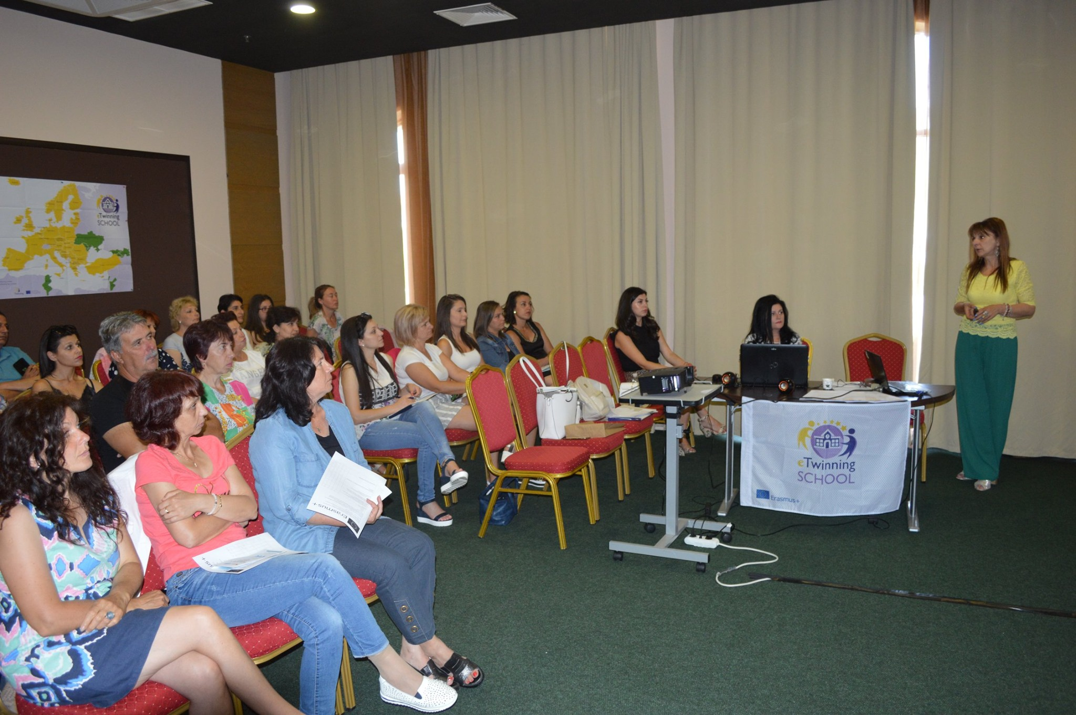
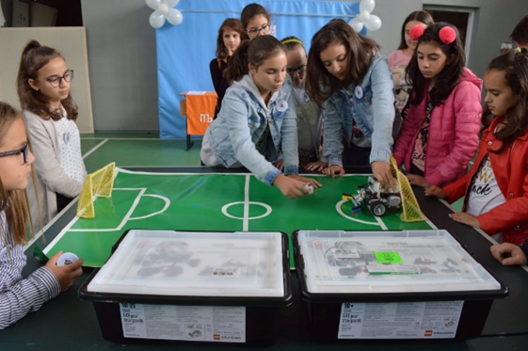
The school principal is an ICT lecturer and she is an active Microsoft Country Trainer with two Microsoft Office Certified Specialists.

Slide 13
Thank you for your attention!
Gallery

