Slide 1
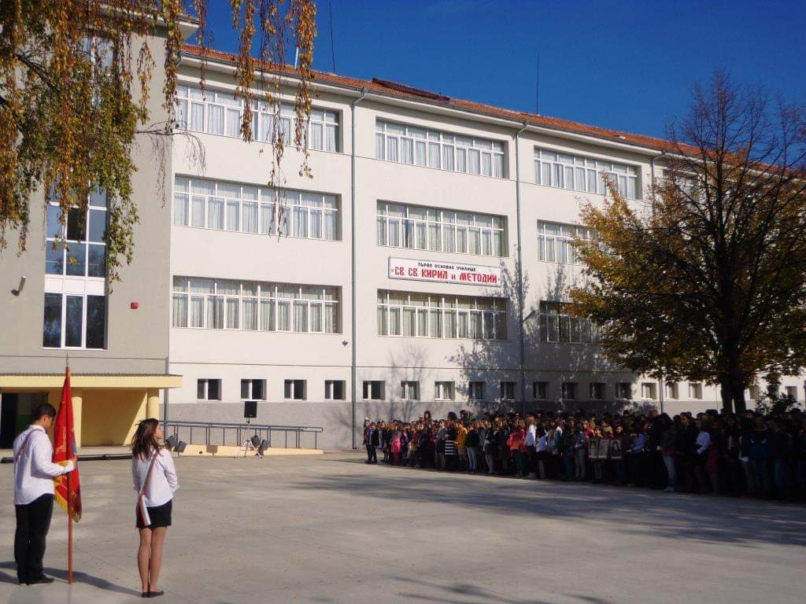
‘’First Primary School St. St. Cyril and Methodius”.
‘’First Primary School St. St. Cyril and Methodius”.

Slide 2
Menu
Location
Teachers and students
School subjects
School Daily routine
Hobbies and Clubs
School clubs

Slide 3
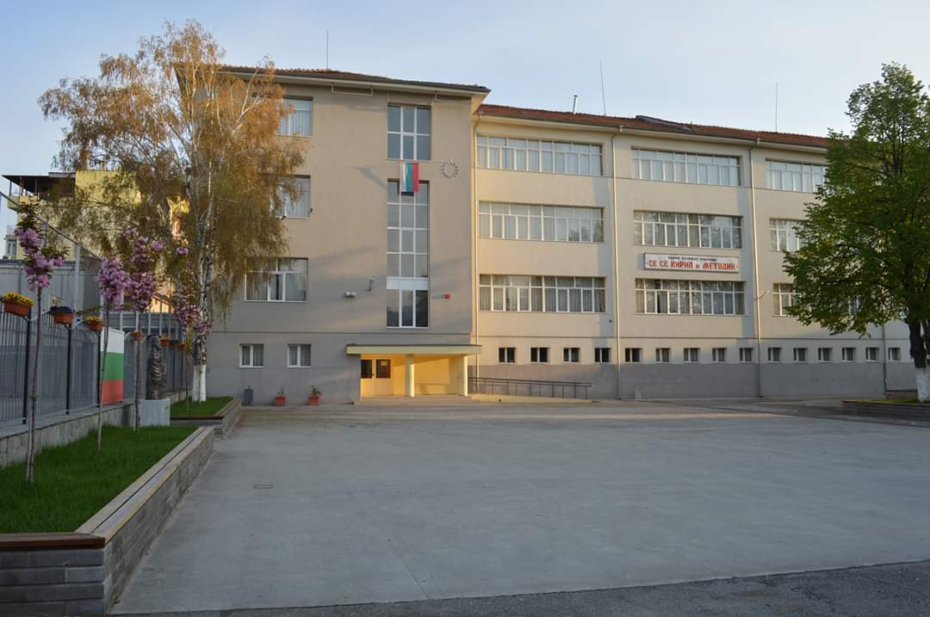
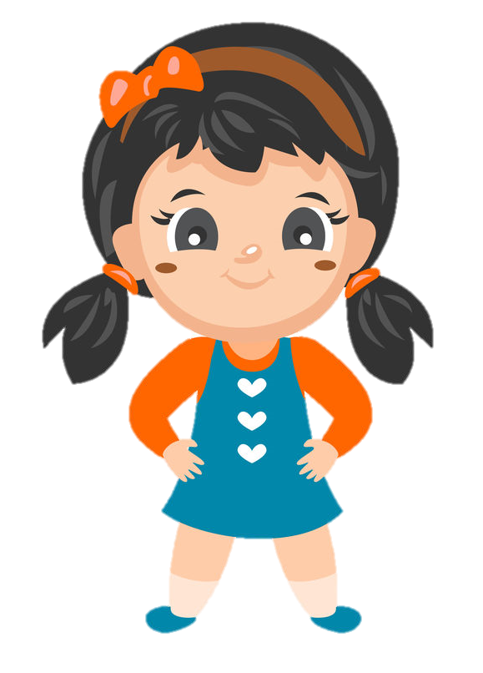
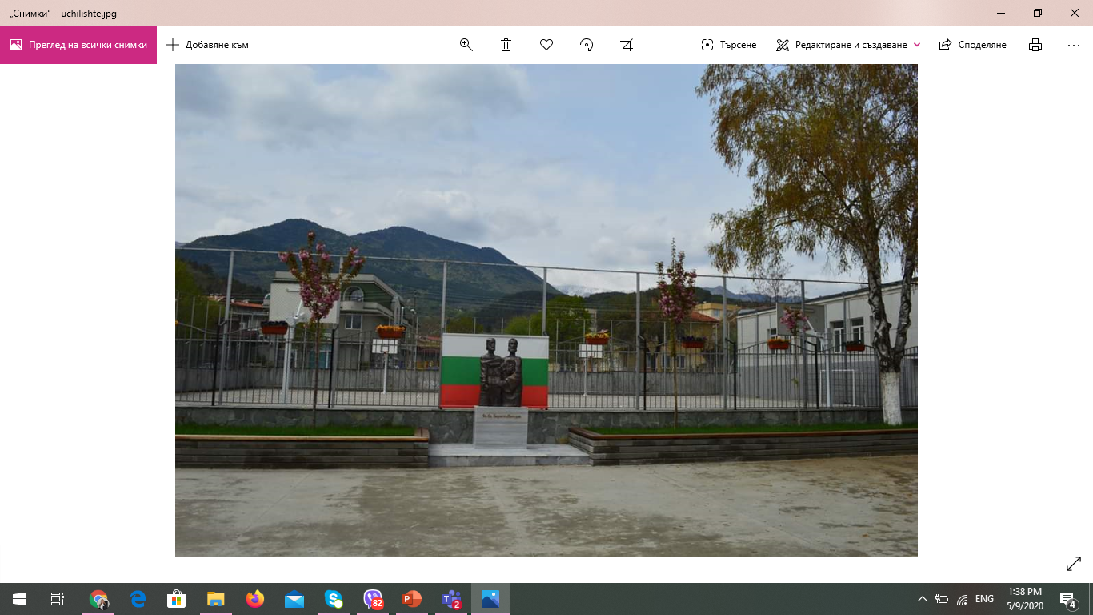
Location
I study in one of the best school of country. My school name is First primary school ‘’St. St. Cyril and Methodius”.

Slide 6
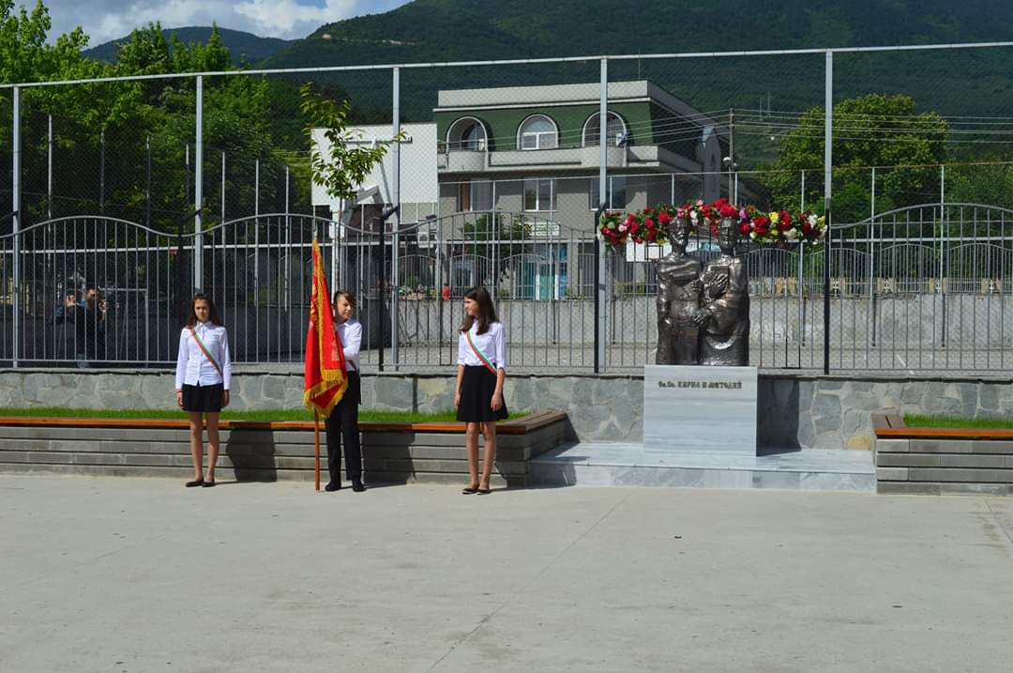
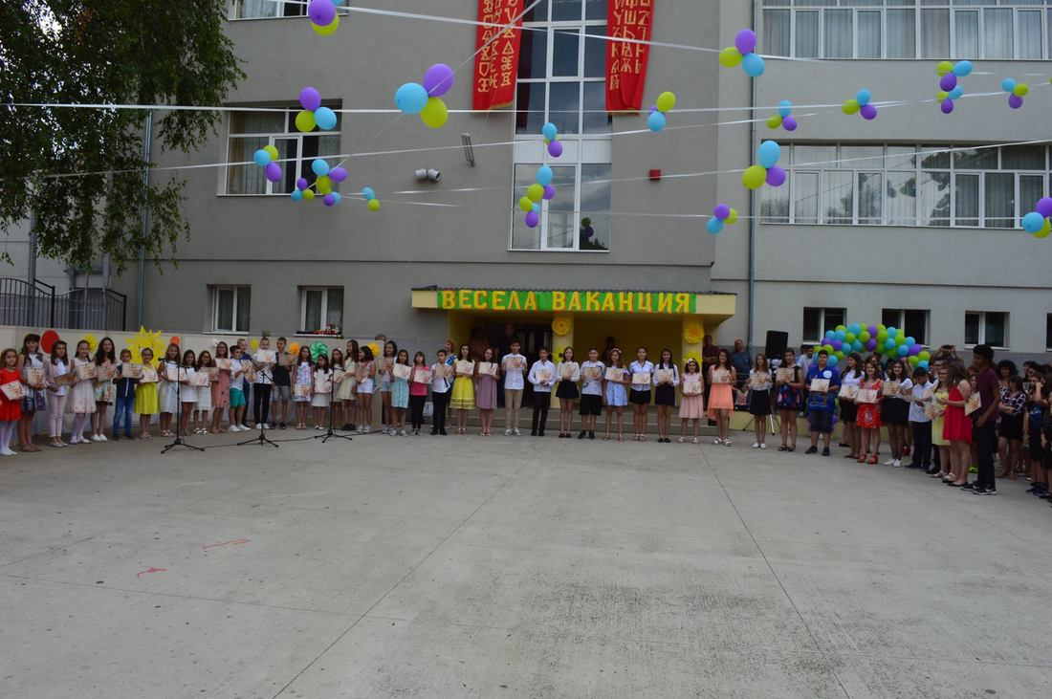
Location
My school has a great history of serving my country. It has a big and beautiful building that looks shiny from far away….

Slide 9
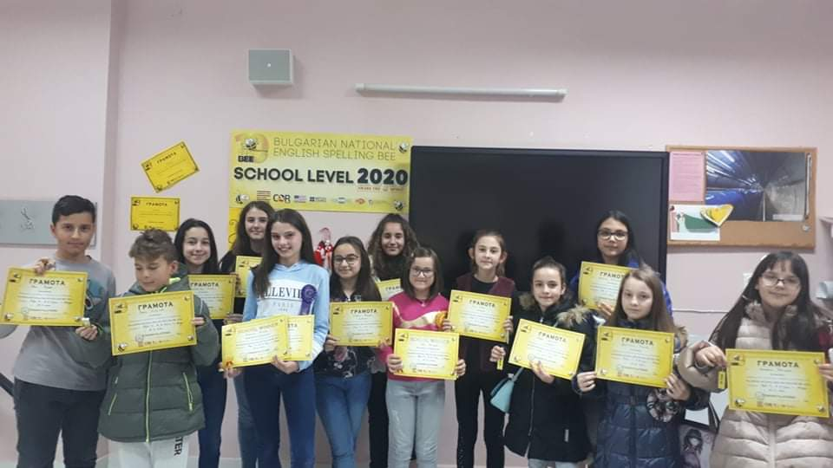
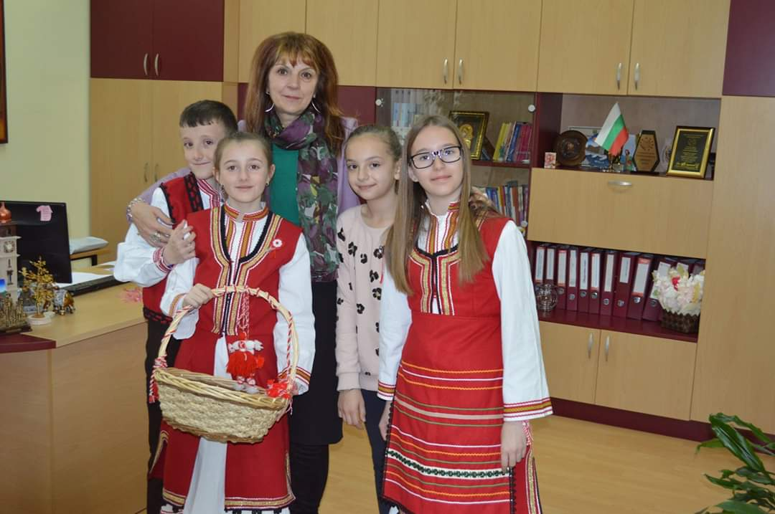
Teachers and students
The teachers are 49 and they are all experienced and qualified. That’s why students and their parents prefer our school.

Slide 12
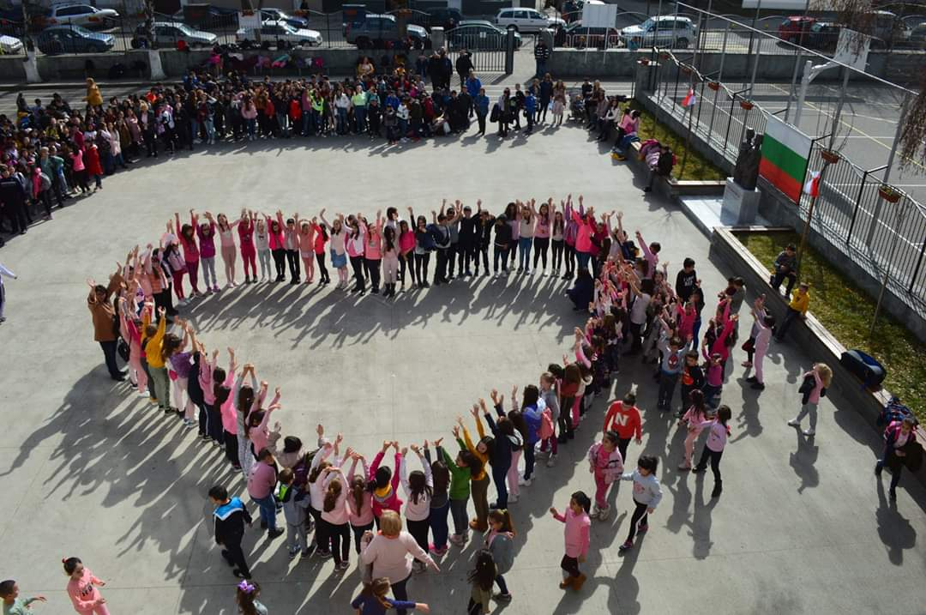
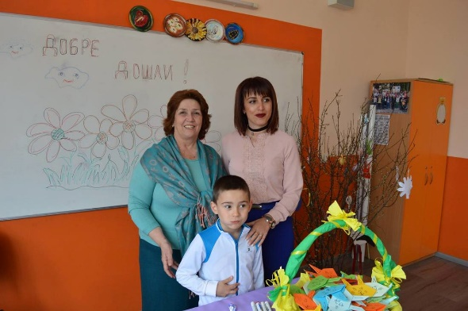
Teachers and students
Students receive a great education and win contests and competitions organized by the Bulgarian Ministry of Education. There are over 600 students, aged 7 -13.

Slide 15
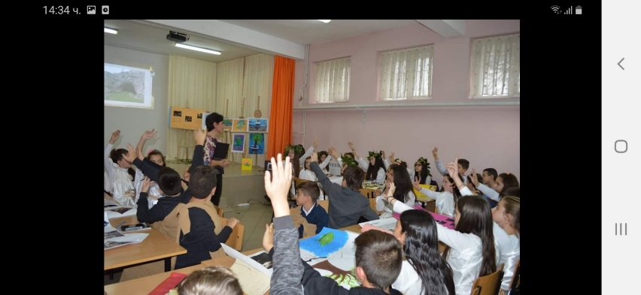
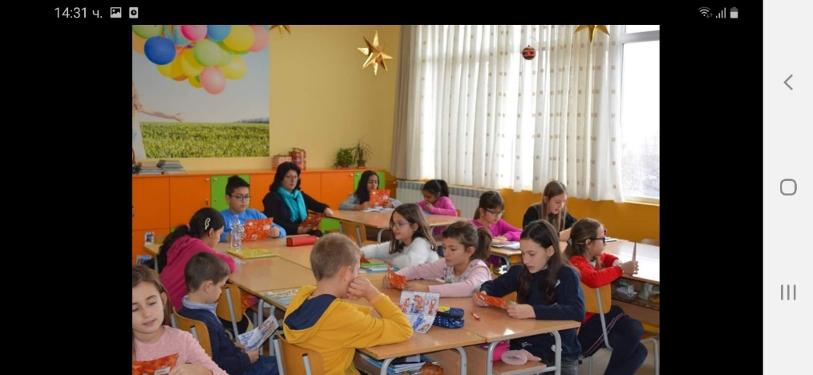
School subjects
Subjects fall into the following major areas of content: Bulgarian language and literature, Foreign languages, Mathematics, Information technologies, Social sciences, Natural sciences, Music, Art, Sports.

Slide 18
School subjects
Students from grades 1 through 7 normally spend half a day in school Тhe other half is dedicated to homework and independent study at home.

Slide 20
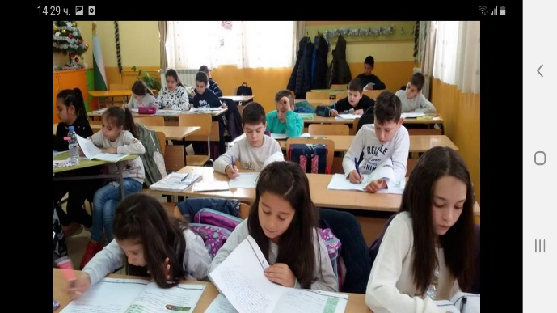
School subjects
In elementary school and sometimes in pre secondary school there exists an option called zanimalnya (extended care) for students to spend the other half of the day in school working on their lessons under the control of a teacher.

Slide 22
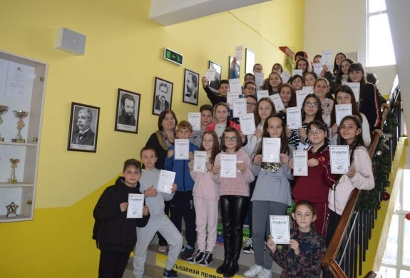
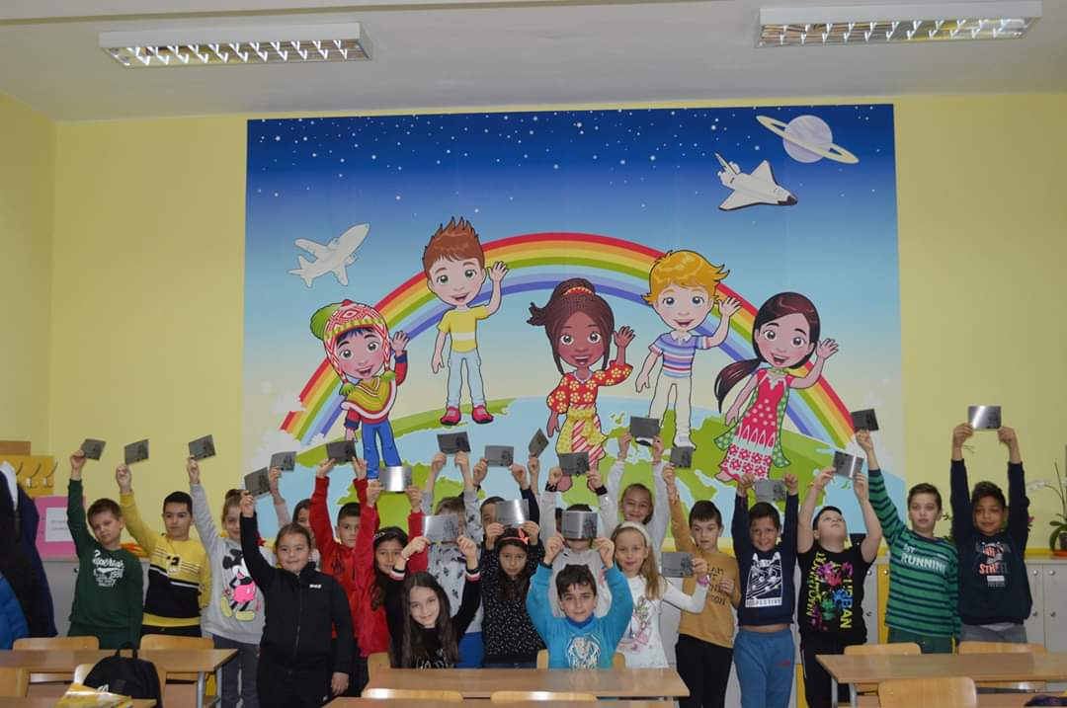
School Daily routine
Children from second, third and fourth grade study in the afternoon and the other in the morning. The number of students in a class is about 24.

Slide 25
Hobbies and Clubs
We are proud of our school because it provides us all the basic facilities like a big playground, a central library, a big auditorium hall, a science lab and a good computer lab. We study under the guidance of the best teachers. The library of our school is very big and keeps the books for all the students

Slide 26
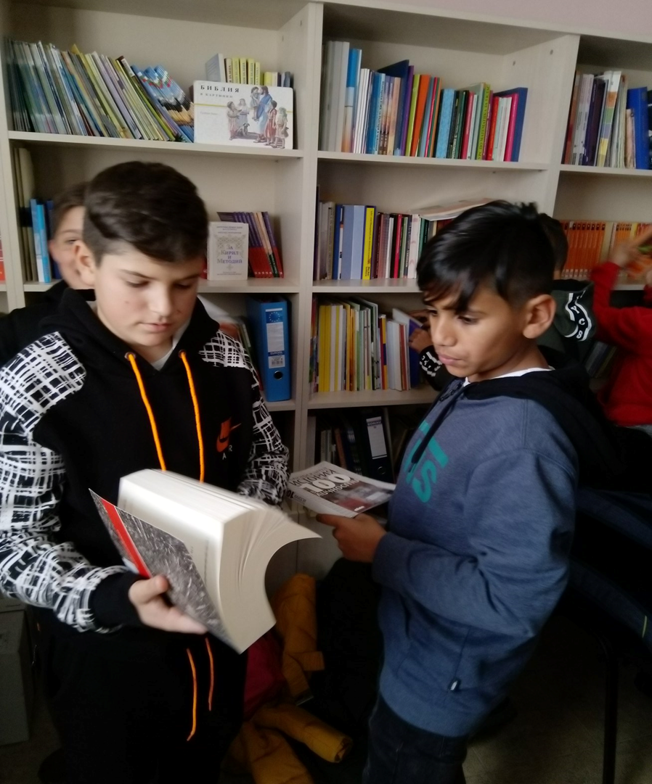
Library

Slide 27
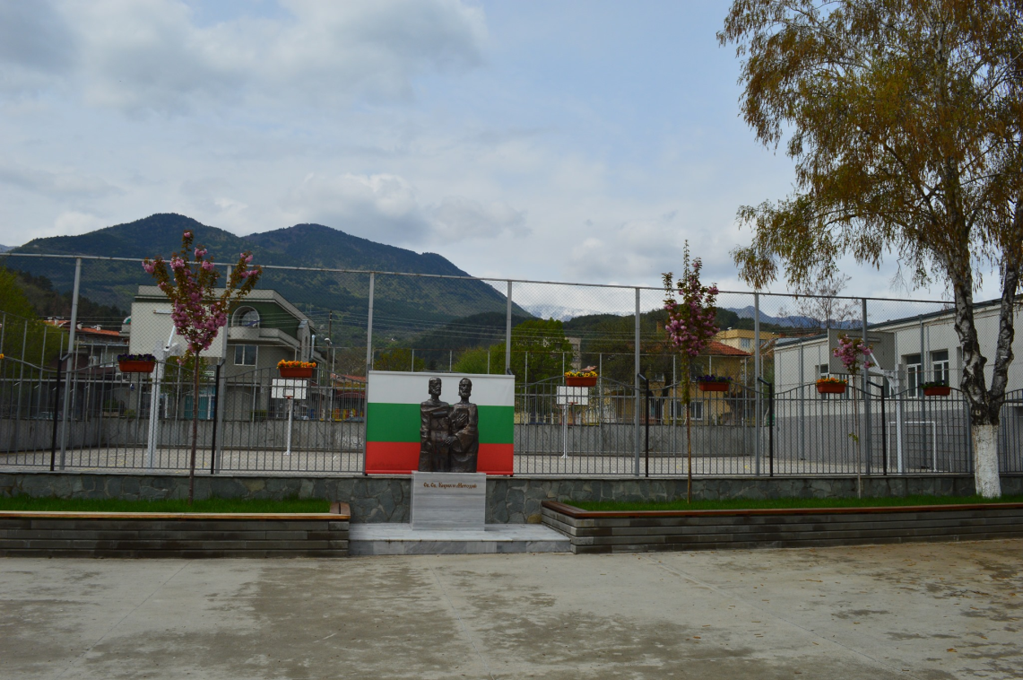
Playground

Slide 28
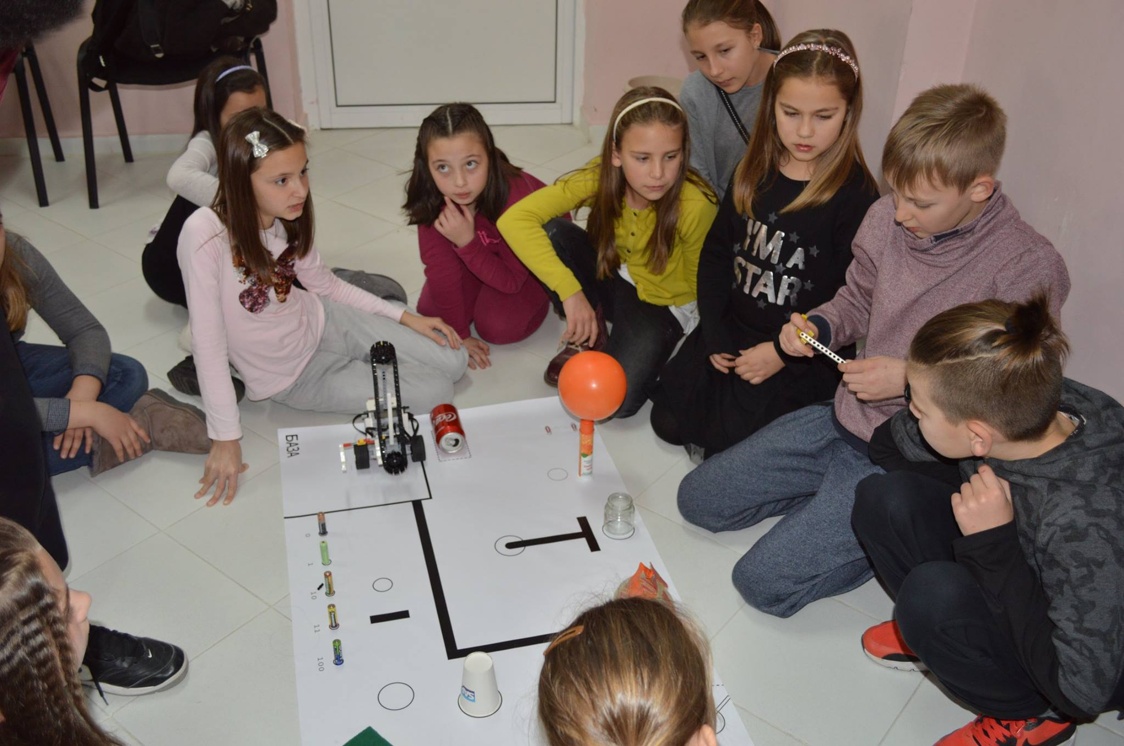
Science room

Slide 29
School clubs
We take part in all school activities like singing, dancing, quiz competition, writing competition and others. In fact, it is the result of the hard work done by our teachers.

Slide 30
School clubs
First primary school
“St. St. Cyril and Methodius”
Gotse Delchev, Bulgaria

